Slide 1
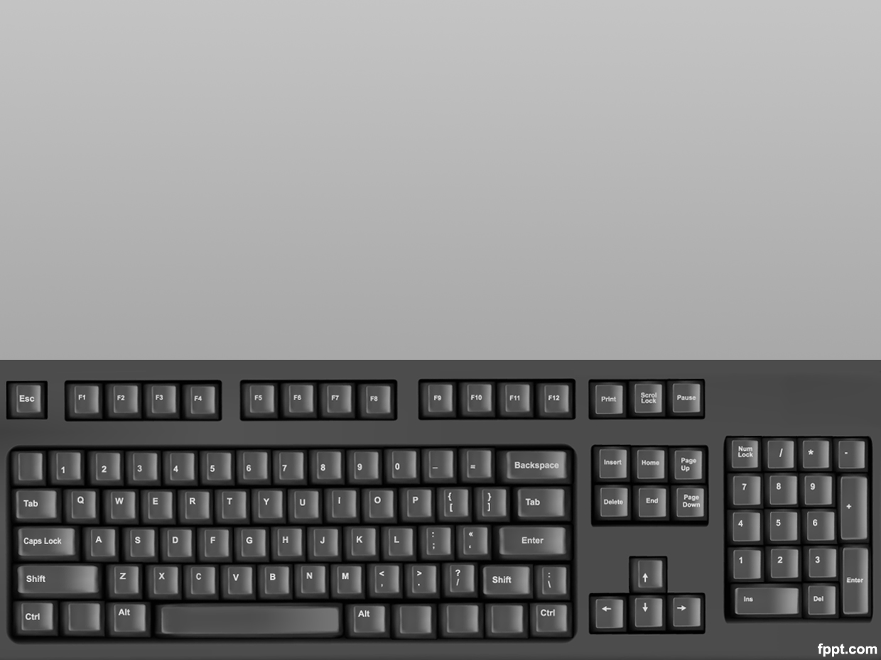





Slide 2
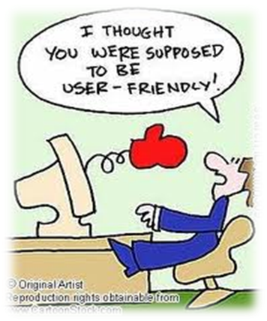




The Problems of Compilation

Slide 3




e-Compiler - is an application which greatly lightens the user’s workload at the initial stage of programming.
During this initial period the users will neither have to deal with the complexities of the installation and the conﬁguration of compiler tools, nor with the understanding of multiple options which the software presents.
With an online compiler, the user can store the code online, compile and execute it, allowing him the freedom to program from any computer (or device) with a connection to the internet.

Slide 4

The product, e-Compiler, is a web application where users can compile and execute their code online using a web browser.
The features of the application include a user account for the user, wherein he/she can login and save his/her codes.
The product also facilitates the user to share the code with other users. The user can choose from a given set of programming languages and compile and execute the code.

Slide 5





GUI: HTML and CSS
Back-end: PHP
MySQL for Database

Slide 6


Slide 7


